Slide 1

Religion & Human Experience Revision
Lesson 2
A RE lesson created by Mr Betts

Slide 2



Ormiston Venture Academy Humanities Faculty
TOPIC: Revision Lessons
TITLE: Beliefs & teachings (Conflict & Medicine)
Previous Learning: (Revision lesson 1 – Key terms)
To understand both religious teachings from the ‘Conflict’ and ‘Medicine’ units
Learning Outcomes
A*-B
The outcome of today's learning will be: To check our understanding of key terms and complete mind mapping task as a revision aid.
C-D
To be able to explain most beliefs and teachings from the ‘Conflict’ and ‘Medicine’ units
E-G
To know key terms and recall a few religious beliefs
Learning Activities
Key word check
Mind mapping
Exam practice
Assessment of Learning
Q&A
Key word check
Written work

Slide 3



Starter
Your task to fill in the missing key term (Use your guide if you need help).

Slide 4
What is the key term? | Relationships/Is it fair?/Looking for meaning/Our World | The meaning of the term is…
Hippocratic Oath |  | An oath made by doctors to promise to protect life
Just War |  | A war that can be justified according to certain conditions. Example: A good cause
 |  | The moral principals that affect medical issues and practices. Example: Euthanasia
Non-Violent Protest |  | Showing disapproval without damaging property or using any violence. Example: Marching/Petitions
Reconciliation |  | Making up and saying sorry after a quarrel or dispute and working together again. Example: Forgiving each other.
Pacifism |  | The belief that any form of violence or war is unacceptable. Example: Refusing to fight in wars
Sanctity Of Life |  | The belief that life is precious, sacred and Holy. Example: Humans made in the image of God
Conflict |  | Clashes and breakdown of relationships. Example: Fighting.
Quality Of Life |  | The extent to which life is pleasurable and meaningful. Example: Being healthy and having a home

Slide 5
What is the key term? | Relationships/Is it fair?/Looking for meaning/Our World | The meaning of the term is…
 | Hipocratic oath | An oath made by doctors to promise to protect life
 | Just war | A war that can be justified according to certain conditions. Example: A good cause
 | M | The moral principals that affect medical issues and practices. Example: Euthanasia
 | N | Showing disapproval without damaging property or using any violence. Example: Marching/Petitions
 | R | Making up and saying sorry after a quarrel or dispute and working together again. Example: Forgiving each other.
 | P | The belief that any form of violence or war is unacceptable. Example: Refusing to fight in wars
 | S | The belief that life is precious, sacred and Holy. Example: Humans made in the image of God
 | C | Clashes and breakdown of relationships. Example: Fighting.
 | Q | The extent to which life is pleasurable and meaningful. Example: Being healthy and having a home

Slide 6



Research the work and life of the following 5 people/organizations. This information will really help you to answer some D Questions in the exam.
Oscar Romero
Martin Luther King
Christian Aid
Islamic Relief
Corrymeela

Slide 7

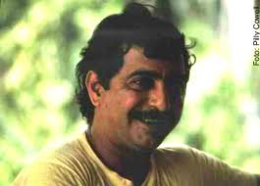

Last lesson your were asked to research the work and life of the following 5 people/organizations. This information will really help you to answer some D Questions in the exam.
Oscar Romero
Martin Luther King
Christian Aid
Islamic Relief
Corrymeela

Slide 8
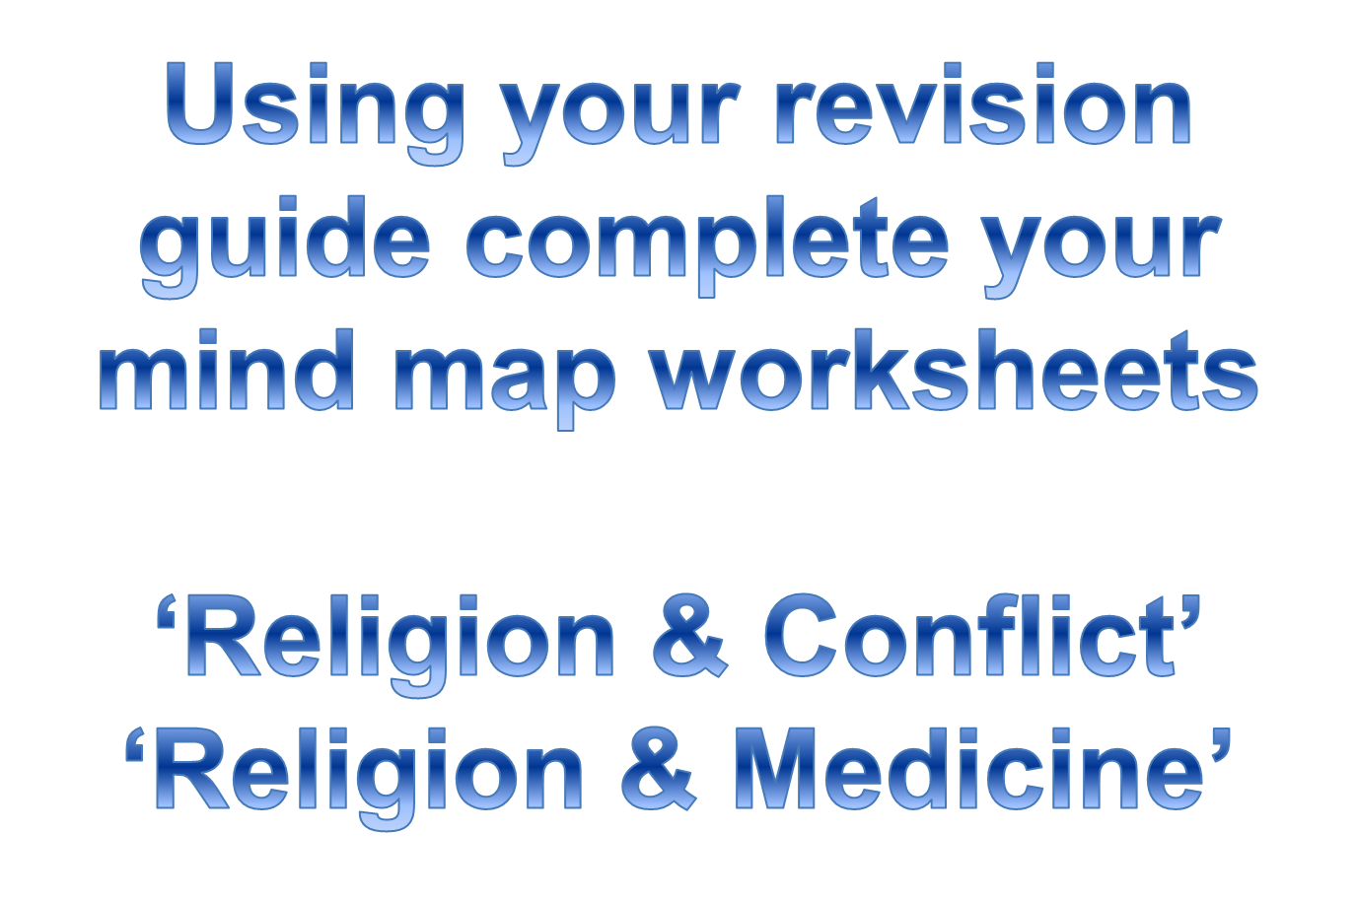
Main Task

Slide 9







Islam
Allah commanded everyone to have fun and enjoy life.
Islam
Those who forgive will be rewarded by Allah.
War
Forgiveness
Christian/Catholic
Christian/Catholic
Retaliation when wronged is not helpful.
Sometimes necessary to go to war if it is a JUST WAR.
Islam
Islam
Suffering is a test from Allah.
Suffering
Interfaith Dialogue
Christian/Catholic
Christian/Catholic

Slide 10


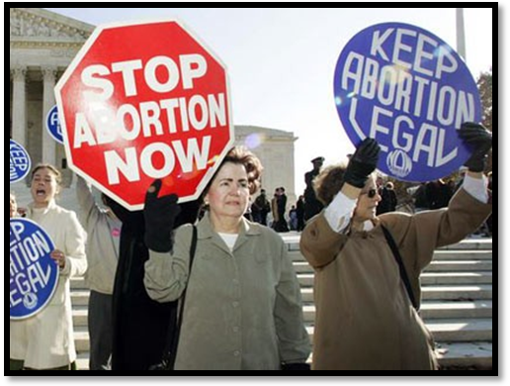
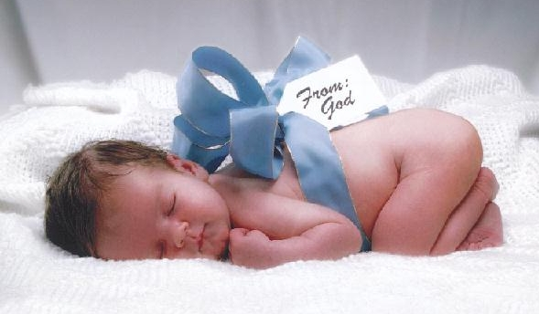
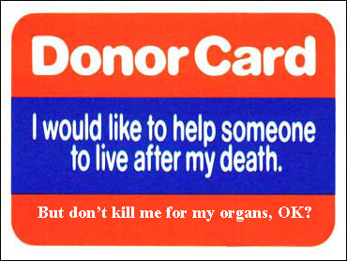
Islam
Only Allah should take away life.
Islam
IVF (Fertility treatment)
Abortion
Christian/Catholic
Christian/Catholic
Islam
Organ Donation
Euthanasia
Christian/Catholic

Slide 11



Slide 12


Explain from two religious traditions the teachings about war (6)
Point- War is ok if there is a just cause. Example- Explanation-
“Every couple has the right to a child” (8)
I agree/disagree because… I disagree because it might cause financial problems.
My second reason is… It might cause suffering to those around.
On the other hand Christians/Muslims/Catholics… believe that all life is sacred and everyone is entitled to have a child, as along as it will not cause suffering.
So in conclusion… I believe that not everyone is entitled to have a child.
Explain from two religious traditions the teachings about abortion (6)
Point- Example- Explanation-
Point- Example- Explanation-
“Religion will never achieve peace in the world” (8)
I agree/disagree because… I agree with this statement as most disagreement is towards religion.
My second reason is… Religion raises more questions than it answers.
On the other hand Christians/Catholics/Muslims… on the other hand a group of religions have created the interfaith dialogue which unites these religions together.
So in conclusion… I believe that religion causes many conflicts but not all.

